Slide 1


















DOD OIG PURCHASE REQUEST MATRIX
Quick Reference Guide
REQUIREMENT TYPES
Supplies/Credit Card
Delegated Authority
Single Person
Team Learning
Lecture Hall
Booths/Networking
REQUIRED
REQUIRED
REQUIRED
REQUIRED
REQUIRED
REQUIRED
REQUIRED
REQUIRED
REQUIRED
REQUIRED
(IF SUPPLIES)
RESOURCES & ADDITIONAL GUIDANCE: Consult OIG instruction 4100.XX or policy guidance.
🔗 oig.dod.mil/purchase-request-matrix

Slide 2
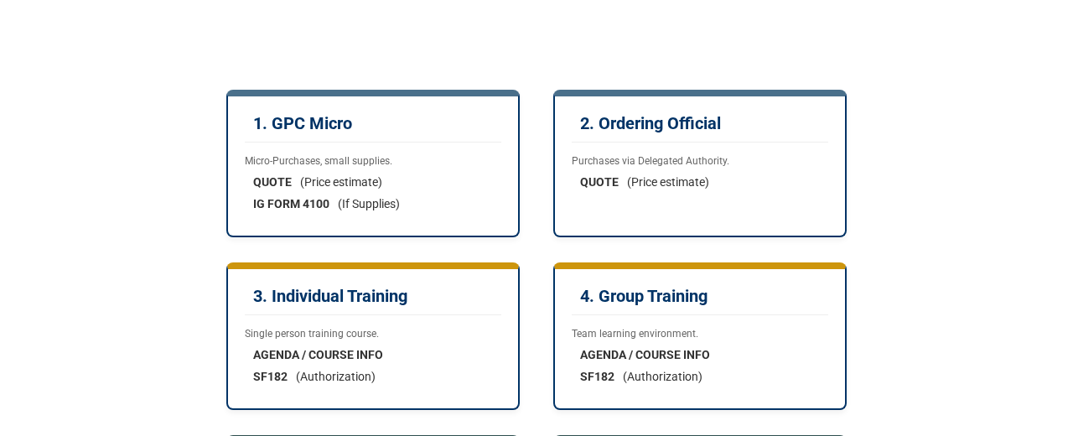

DOD OIG PURCHASE REQUEST MATRIX
Document Requirements by Type
RESOURCES & ADDITIONAL GUIDANCE: Consult OIG instruction 4100.XX.
🔗 Matrix Link for Request Forms

Slide 3




DOD OIG PURCHASE REQUEST MATRIX
SUPPLIES & GENERAL PURCHASES
TRAINING REQUIREMENTS
CONFERENCE ATTENDANCE
1. GPC Micro (Micro-Purchases)
3. GPC Individual Training
5. GPC Training Conference
2. GPC Ordering Official (Delegated)
4. GPC Group Training
6. GPC Informational Conference
QUICK REFERENCE: Select category, find sub-type, attach required documents.
🔗 Download Matrix PDF

Slide 4















DOD OIG PURCHASE REQUEST MATRIX
1. GPC Micro
2. GPC Ordering Official
3. GPC Individual Training
Quote Required
Quote Required
Agenda/Course Info
IG Form 4100 (If Supplies)
SF182 Required
4. GPC Group Training
5. GPC Training Conference
6. GPC Info Conference
Agenda/Course Info
Quote Required
SF182 Required
SF182 Required
Agenda/Course Info
SF182 Required
Need Help? Consult OIG instruction 4100.XX or contact the policy office.
🔗 Shareable Matrix Link

Slide 5






Image Sources
https://www.war.gov/portals/1/Page-Assets/branding-guide/seals/DOW-Seal-BW_sm.png
Source: www.war.gov
https://media.gamestop.com/i/gamestop/20027896/KPop-Demon-Hunters-Mystery-Mini-Backpack-Keychain-Charm-Styles-May-Vary
Source: www.gamestop.com
https://static.vecteezy.com/system/resources/previews/068/984/734/non_2x/legal-authority-symbol-represented-by-a-gavel-illustration-for-justice-vector.jpg
Source: www.vecteezy.com
https://static.vecteezy.com/system/resources/thumbnails/066/400/229/small/simple-outline-tutor-with-student-and-laptop-icon-education-and-teaching-vector.jpg
Source: www.vecteezy.com
https://static.vecteezy.com/system/resources/previews/076/690/412/non_2x/a-presenter-gives-a-lecture-to-a-small-group-of-people-in-a-classroom-setting-vector.jpg
Source: www.vecteezy.com
https://static.vecteezy.com/system/resources/previews/071/753/163/non_2x/simple-line-art-presentation-icon-with-presenter-and-audience-group-outline-vector.jpg
Source: www.vecteezy.com

Slide 6

Image Sources
https://media.istockphoto.com/id/2125124893/vector/teamwork-and-meeting-icons-line-series.jpg?s=612x612&w=0&k=20&c=-0DYVta7SxwaZ4YM1KO_ahM_OMRO8N6wMkJ_MPTfu3I=
Source: www.istockphoto.com

